Slide 1


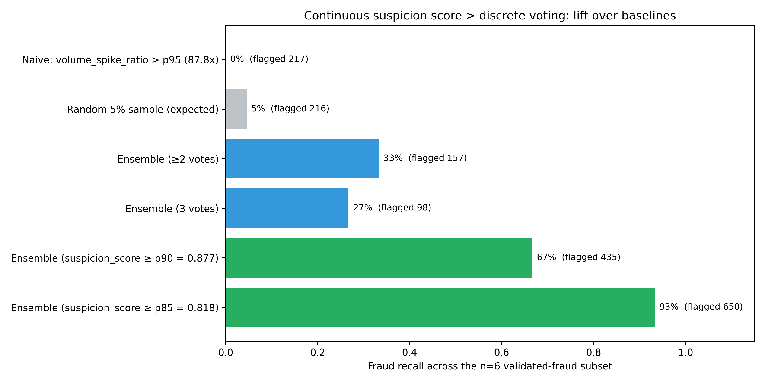
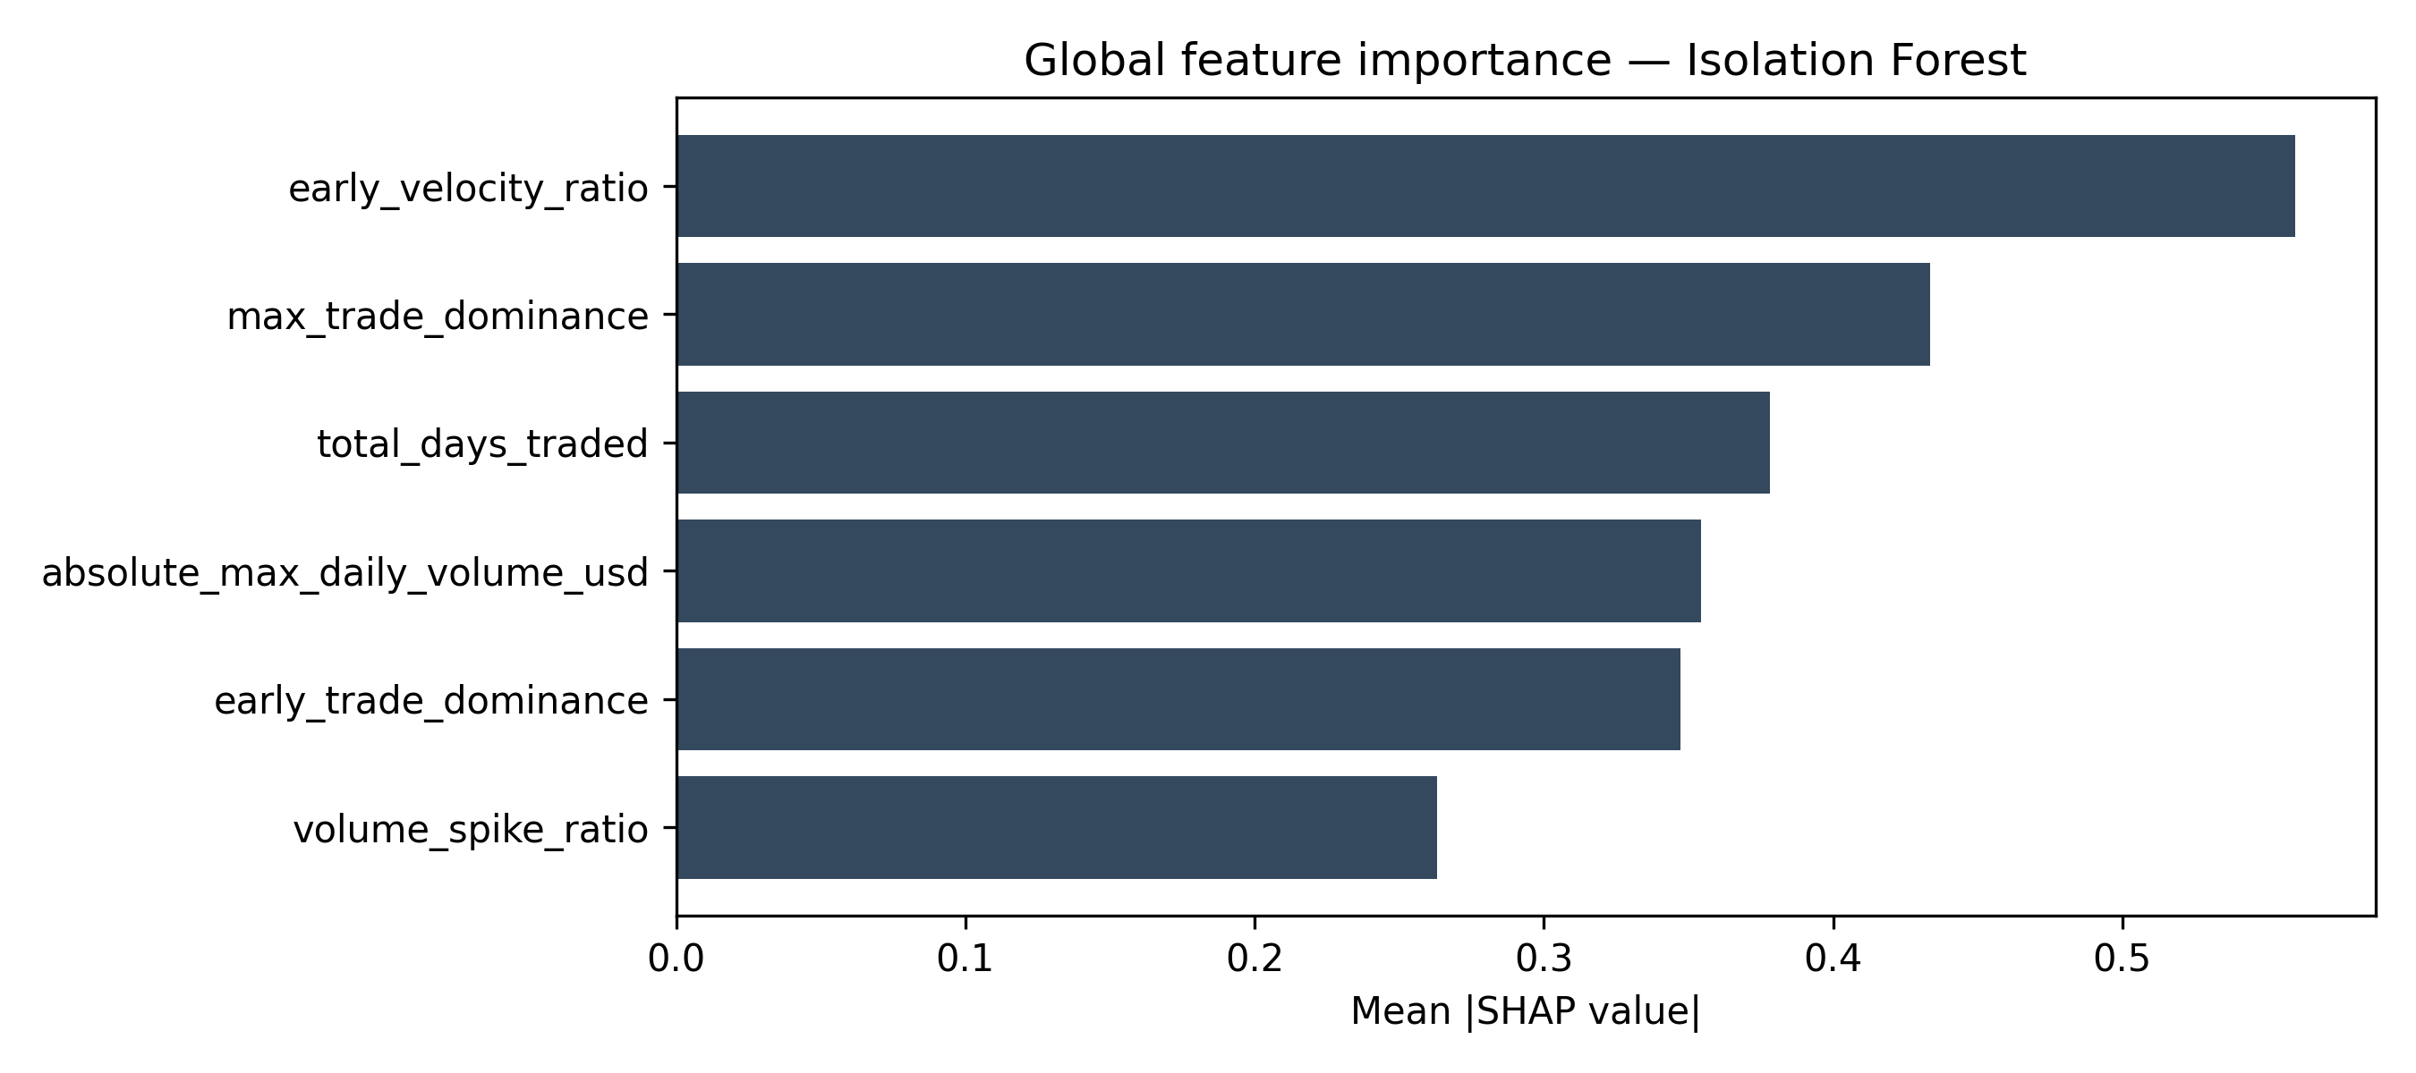
Detecting crypto fraud without labels:
14 of 15 known rug pulls recovered from 4,334 Ethereum tokens.
Gillian Schriever · Jiahui (Cecilia) Cai · Zhilin Chen · Jinghan Huang
Harvard John A. Paulson School of Engineering and Applied Sciences — AC297r Capstone, Spring 2026
① THE QUESTION
② OBJECTIVES
③ METHODS
[ Paste your 'question and motivation' text here. ]
• Why fraud detection on-chain is hard
• Why labels don't work in crypto
• Our two-layer approach in 1–2 sentences
[ Paste your objectives here. ]
Suggested:
• Flag suspicious tokens without supervised labels
• Distinguish fraud from other anomaly types
• Validate against documented rug-pulls and hacks
• Deliver an interpretable, reproducible pipeline
[ Paste your methods here. ]
Suggested:
• 4,334 mid-cap ERC-20 tokens (Dune Analytics)
• Six features; rank-averaged across three detectors
(Isolation Forest + DBSCAN + PCA/Mahalanobis)
• Layer-2 logistic regression on n = 144 labels,
evaluated by leave-one-out CV
④ RESULTS
⑤ FIGURES
⑥ REFERENCES
14 / 15
[1] Mazorra, B. et al.
Do Not Rug on Me: Zero-Dimensional Scam
Detection. arXiv:2201.07220, 2022.
[2] Liu, F. T., Ting, K. M., & Zhou, Z.-H.
Isolation Forest. ICDM, 2008.
[3] Ester, M., Kriegel, H.-P., Sander, J., & Xu, X.
A density-based algorithm for discovering
clusters. KDD, 1996.
[4] Lundberg, S. M. & Lee, S.-I.
A unified approach to interpreting model
predictions. NeurIPS, 2017.
[ Add additional references here. ]
known frauds recovered at the p85 suspicion cutoff.
Legacy three-vote consensus recovered 4 of 15.
[ Paste any additional results text here. ]
• Layer-2 LOO accuracy: 0.87
• Specificity on non-fraud: 88%
• Detected a coordinated rug cluster
(ORBDEG / SPHERUM / ORBS)
Fig. 1. Fraud recall across strategies (n = 144).
Fig. 2. SHAP importance — Isolation Forest.
⑦ CONCLUSIONS
[ Paste your conclusions / 'so what' here. ]
Suggested talking points:
• Continuous ranking beats discrete voting (14 / 15 vs. 4 / 15 fraud recall) — the headline result of the project.
• Two layers separate 'anomaly' from 'fraud.' Layer-2 specificity of 88% means blue-chip false alarms
(WLFI, DEGEN, 3Crv, MIM) are correctly dismissed while known rugs (WFT, PLASMA, ORBDEG cluster) score > 0.8.
• Honest limitations — small-volume honeypots (HYPER, KUBO) still slip through; catching them needs
graph-level signals (deployer history, liquidity-pool removal) beyond on-chain volume features.
• Next step — grow the labeled registry further and add a Layer-3 graph feature set.
Code: github.com/gschriever/AC297r-crypto-fraud-detector Contact: [ name ] · [ email ] Advisor: [ advisor ]

